Slide 1
중간고사 10/22 화요일 아침 9시 – 10시

Slide 2
2.8 Procedure Calling
Steps required
Place parameters in registers
Transfer control to procedure
Acquire storage for procedure
Perform procedure’s operations
Place result in register for caller
Return to place of call
§2.8 Supporting Procedures in Computer Hardware

Slide 3
Procedure Call Instructions
Procedure call: jump and link
jal ProcedureLabel
Address of following instruction put in $ra
Jumps to target address
Procedure return: jump register
jr $ra
Copies $ra to program counter
Can also be used for computed jumps
e.g., for case/switch statements

Slide 4
Handling a Procedure Call
jal & jr commands are used in pairs.
Example : ultimately simple example
main procedure subroutine
.text
.globl main
main: .
.
.
.
jal foo
.
.
.text
.globl foo
foo: .
.
.
.
jr $ra

Slide 5
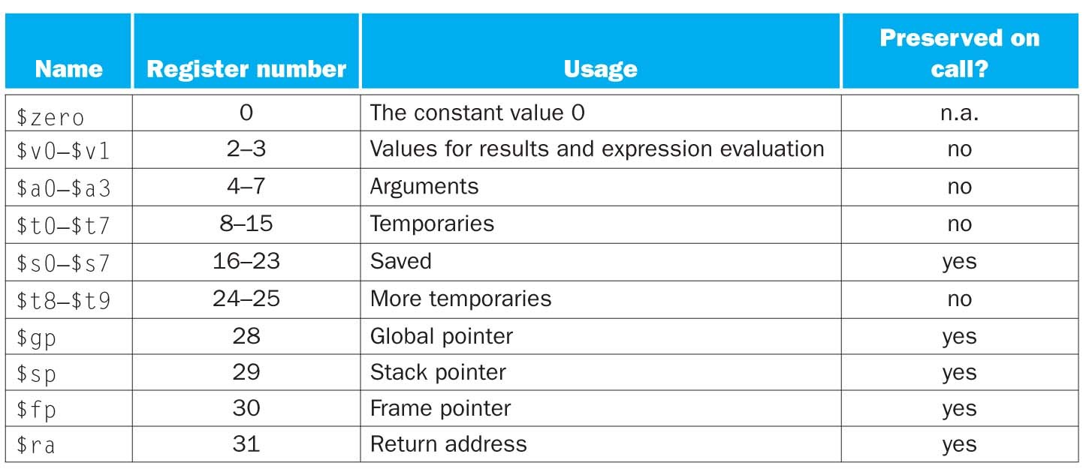
Policy of MIPS Register Use Conventions
How to pass arguments and return values in function call

Slide 6
Register Usage in function call
$a0 – $a3: arguments (reg’s 4 – 7)
$v0, $v1: result values (reg’s 2 and 3)
$t0 – $t9: temporaries
Can be overwritten by callee
$s0 – $s7: saved
Must be saved/restored by callee
$gp: global pointer for static data (reg 28)
$sp: stack pointer (reg 29)
$fp: frame pointer (reg 30)
$ra: return address (reg 31)

Slide 7
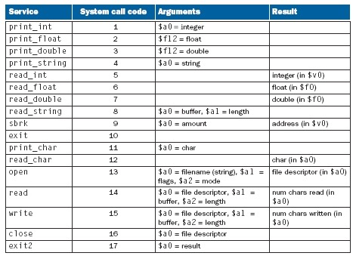
System Calls : calls to functions implemented in OS
Example : addi $v0, $0, 1 # system call code
addi $a0, $0, 10 # argument for the system call, if necessary
syscall

Slide 8
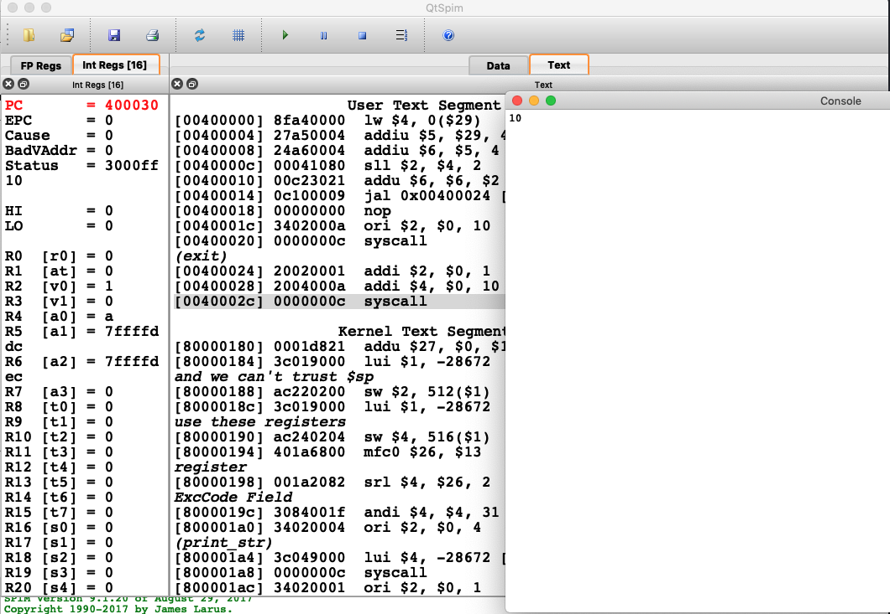

Slide 9
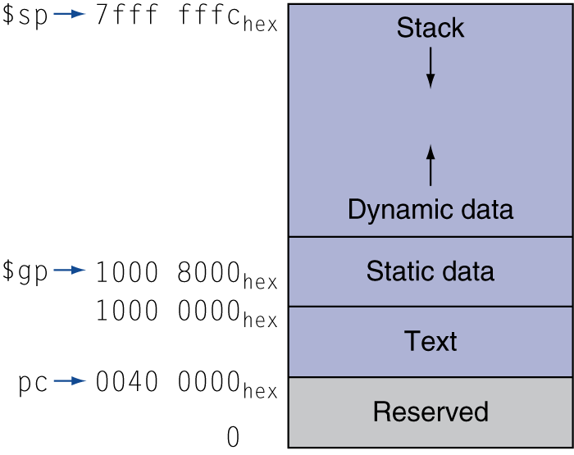
Memory Layout
Text: program code
Static data: global variables
e.g., static variables in C, constant arrays and strings
$gp initialized to address allowing ±offsets into this segment
Dynamic data: heap
E.g., malloc in C, new in Java
Stack: automatic storage

Slide 10
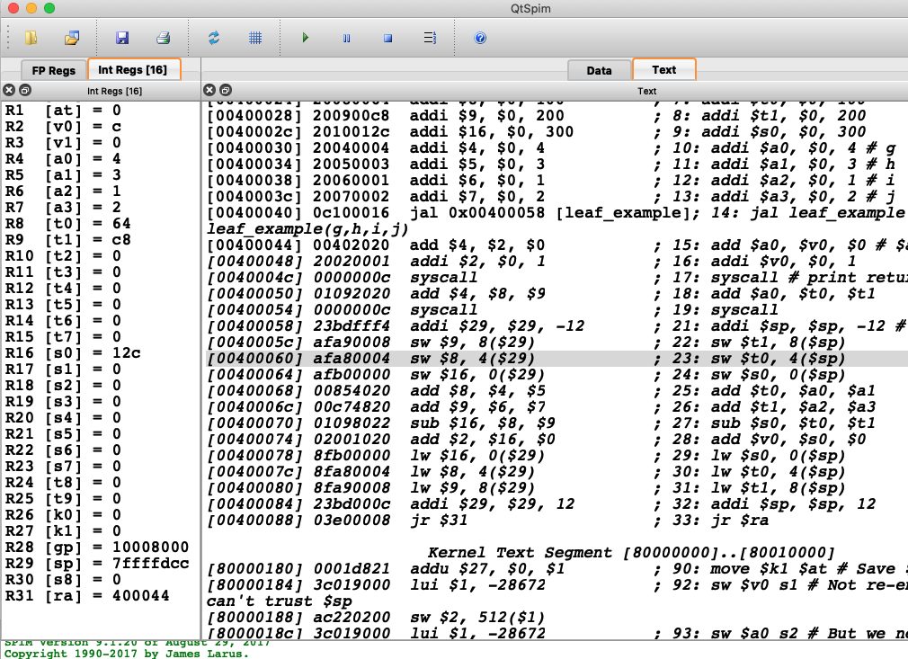

Slide 11
다른 함수를 호출하지 않는 함수라면
C code:
int leaf_example (int g, h, i, j){
int f;
f = (g + h) - (i + j); return f; }
Arguments g,h,i,j in $a0, $a1, $a2, $a3
f in $s0
$s0, $t0, $t1 will be saved on stack.
Result in $v0

Slide 12
Leaf Procedure Example
leaf_example: addi $sp, $sp, -12
sw $t1, 8($sp)
sw $t0, 4($sp)
sw $s0, 0($sp) add $t0, $a0, $a1 # g+h add $t1, $a2, $a3 # i+j sub $s0, $t0, $t1 # f add $v0, $s0, $zero lw $s0, 0($sp)
lw $t0, 4($sp)
lw $t1, 8($sp) addi $sp, $sp, 12 jr $ra
Save $t0,$t1,$s0 on stack
Procedure body
Return value in $v0
Restore $t0,$t1,$s0 from stack
Return to caller function

Slide 13
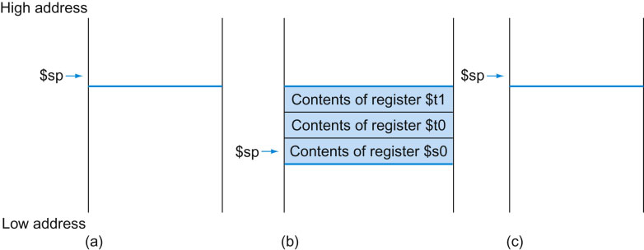
FIGURE 2.10 The values of the stack pointer and the stack (a) before, (b) during, and (c) after the procedure call. The stack pointer always points to the “top” of the stack, or the last word in the stack in this drawing.
Copyright © 2014 Elsevier Inc. All rights reserved.

Slide 14
Why? Caller function
main: addi $t0, $0, 100
addi $t1, $0, 200
addi $s0, $0, 300
addi $a0, $0, 4 # g
addi $a1, $0, 3 # h
addi $a2, $0, 1 # i
addi $a3, $0, 2 # j
jal leaf_example add $a0, $v0, $0
addi $v0, $0, 1
syscall
add $a0, $t1, $t0 syscall
$t0,$t1,$s0 used in caller
set up function arguments
function call
print return value
using system call
print some value
based on values of $t0, $t1:
what happens if these are
not saved?

Slide 15
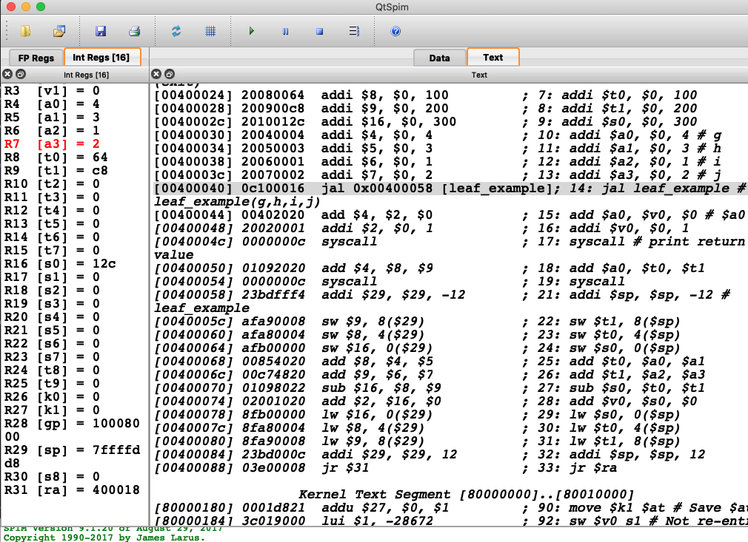

Slide 16
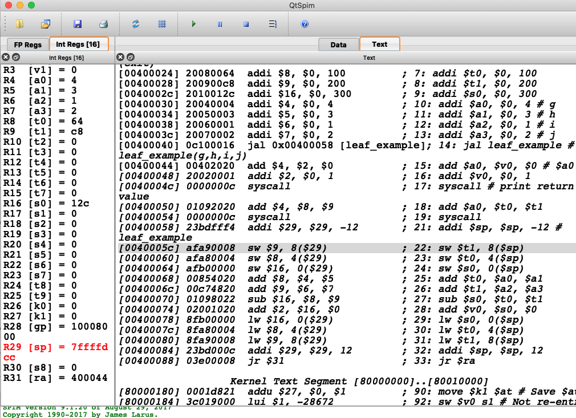

Slide 17
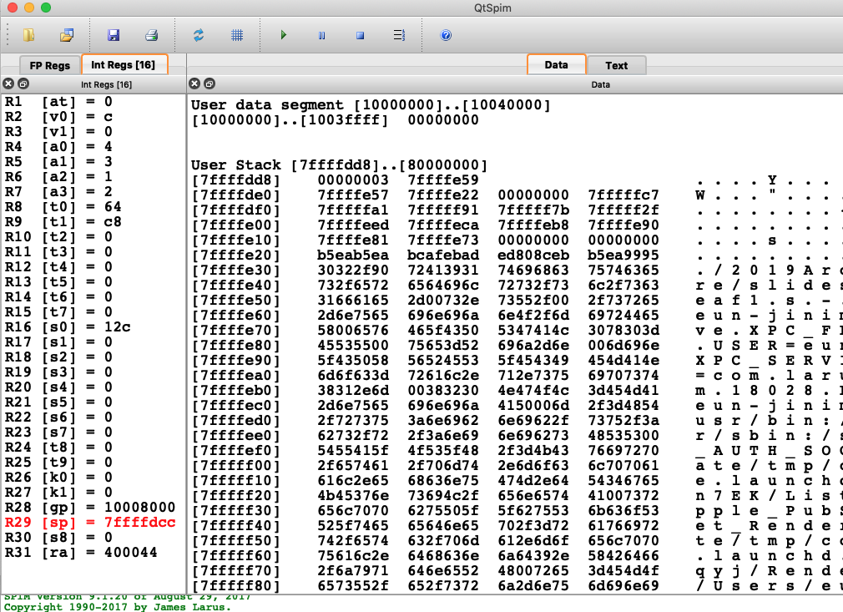

Slide 19
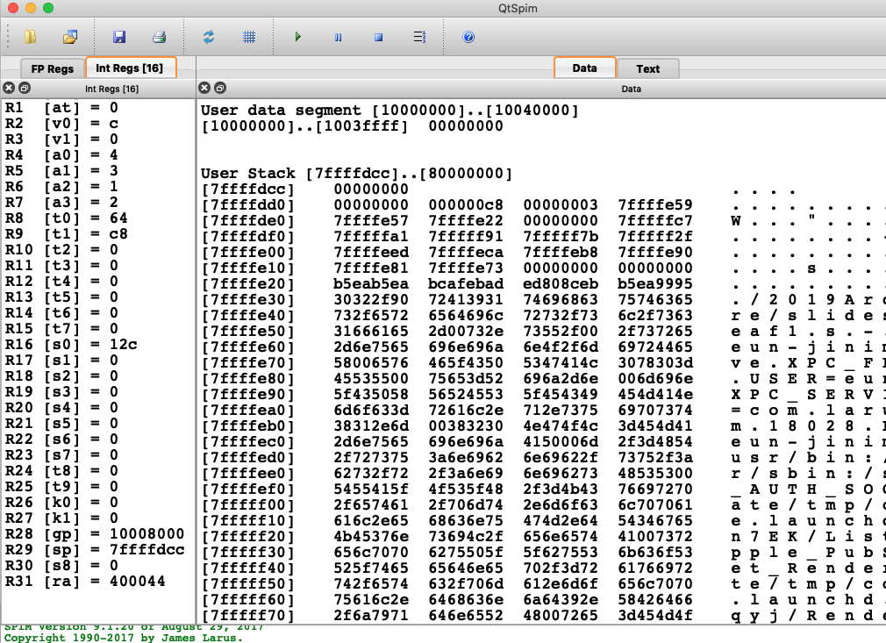
8($sp)

Slide 20
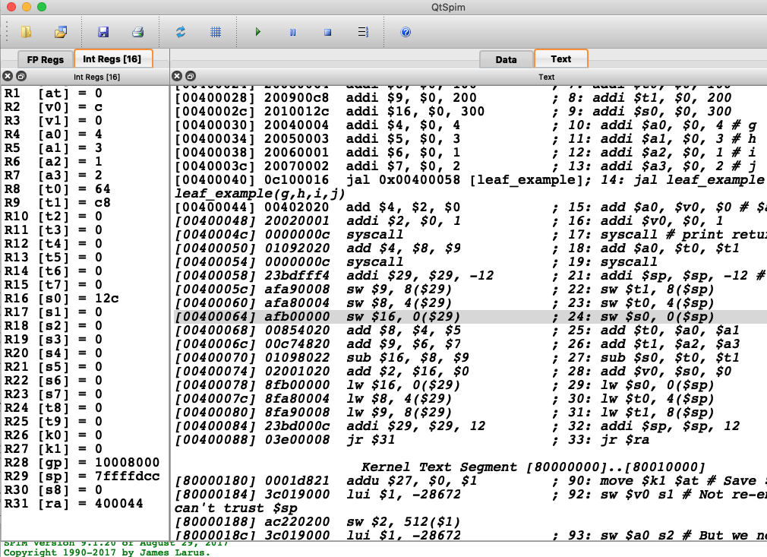

Slide 21
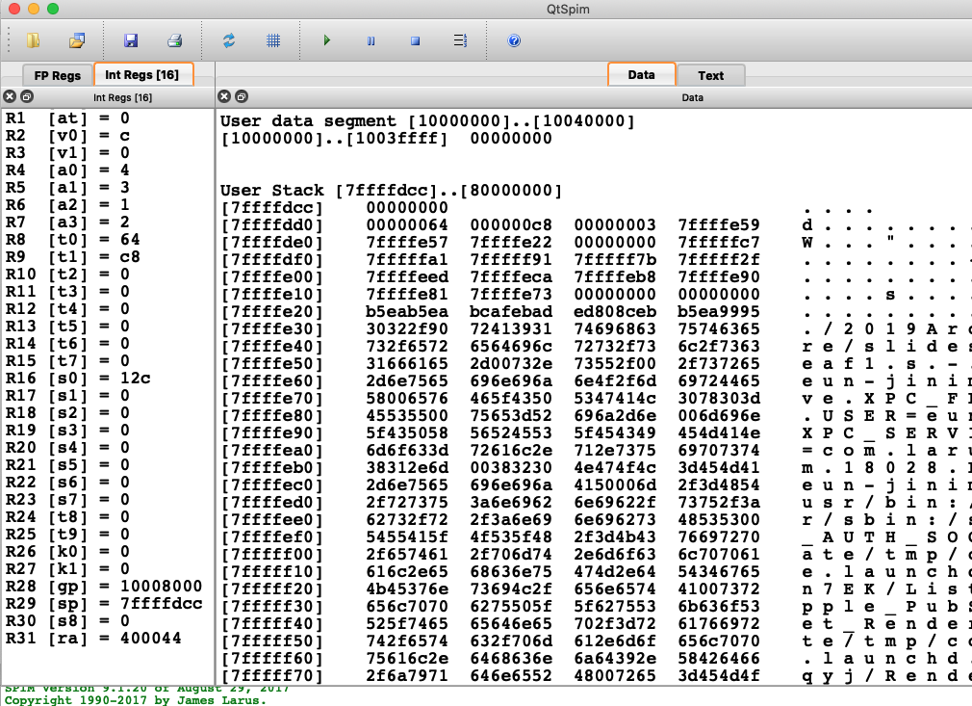
4($sp)

Slide 22
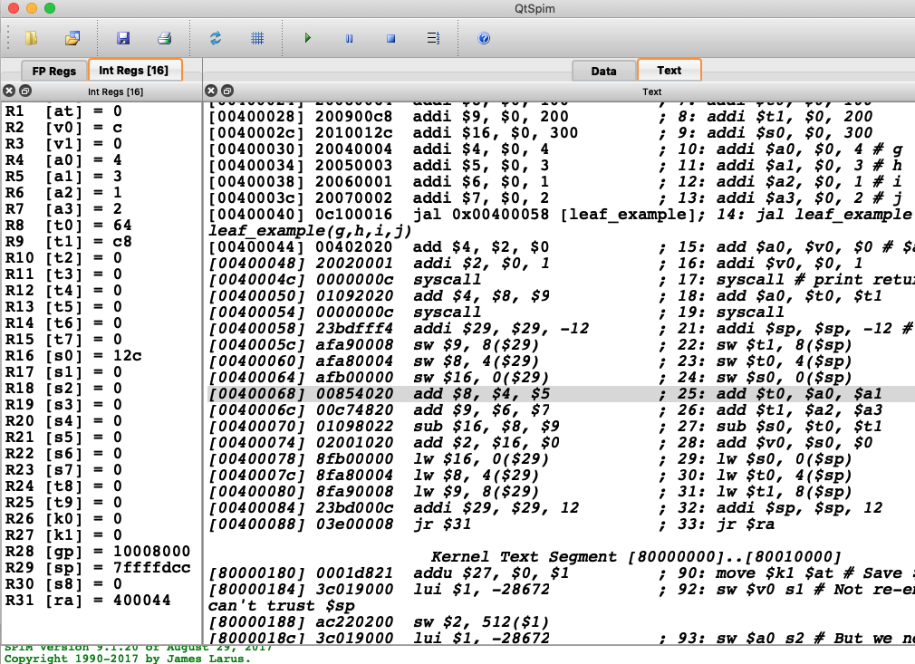

Slide 23

0($sp)

Slide 24
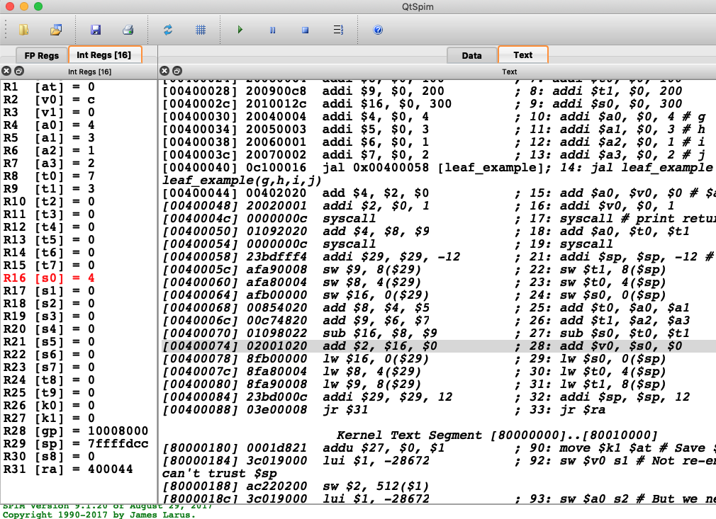

Slide 25
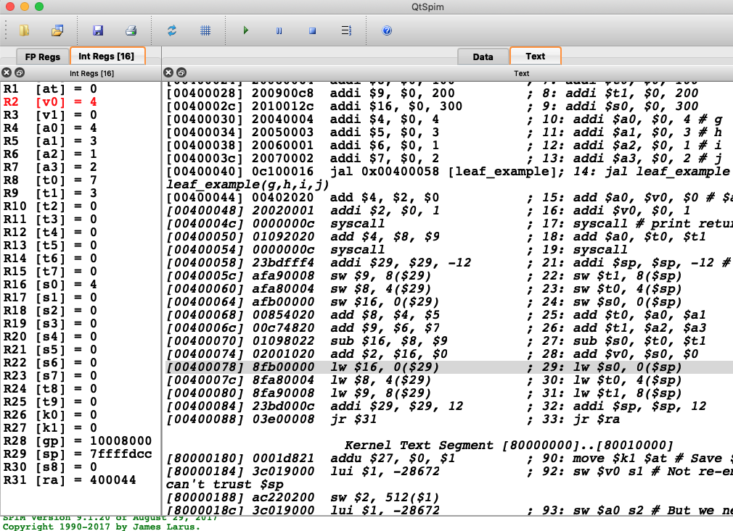

Slide 26
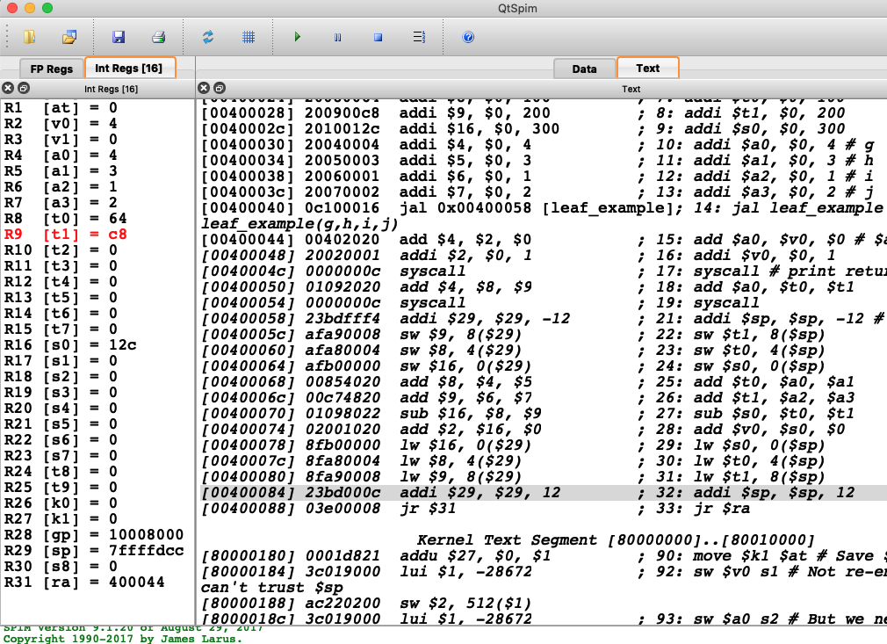

Slide 27
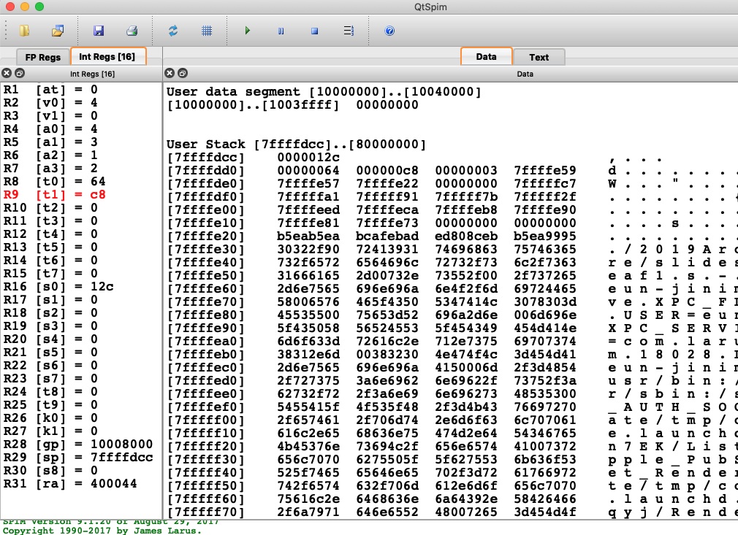

Slide 28
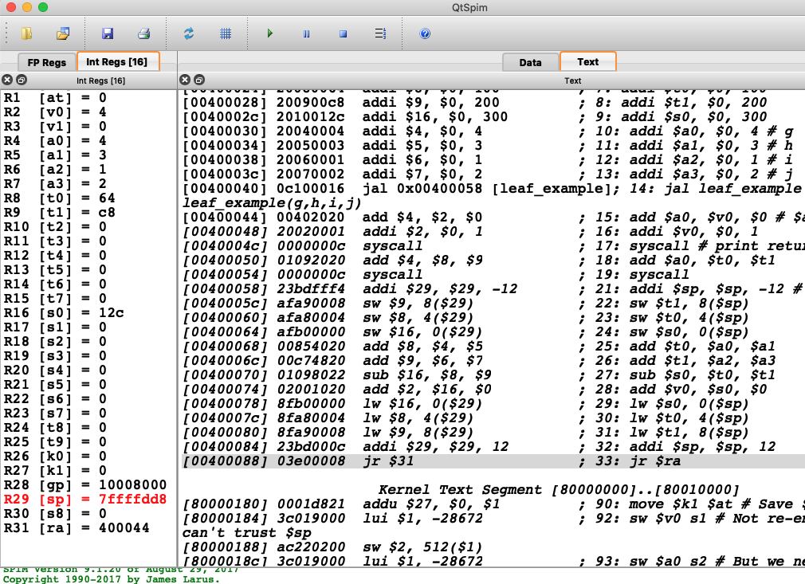

Slide 29
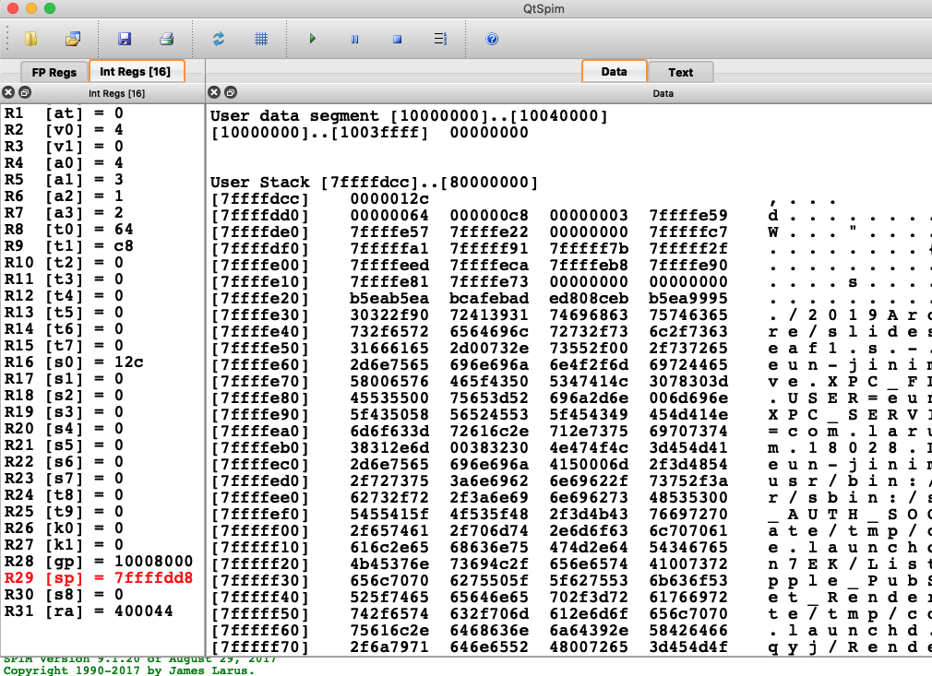

Slide 30
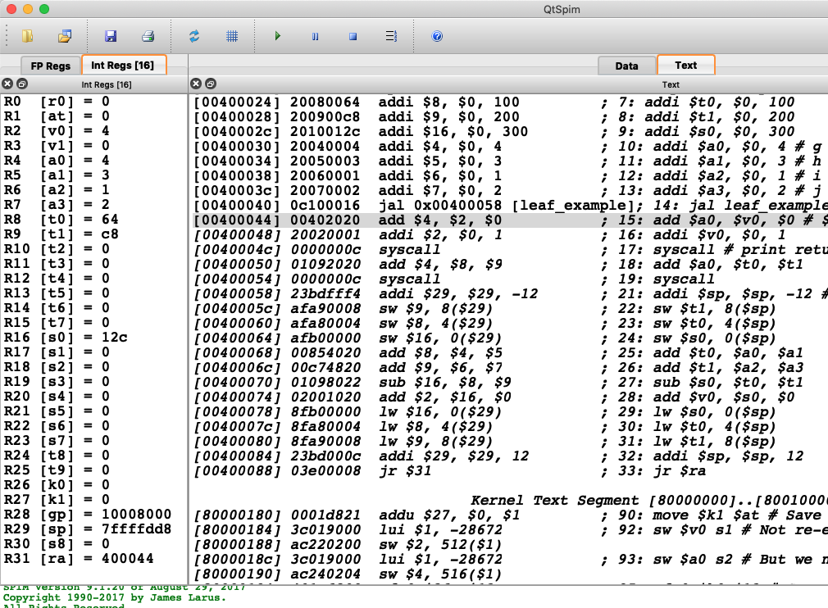

Slide 31
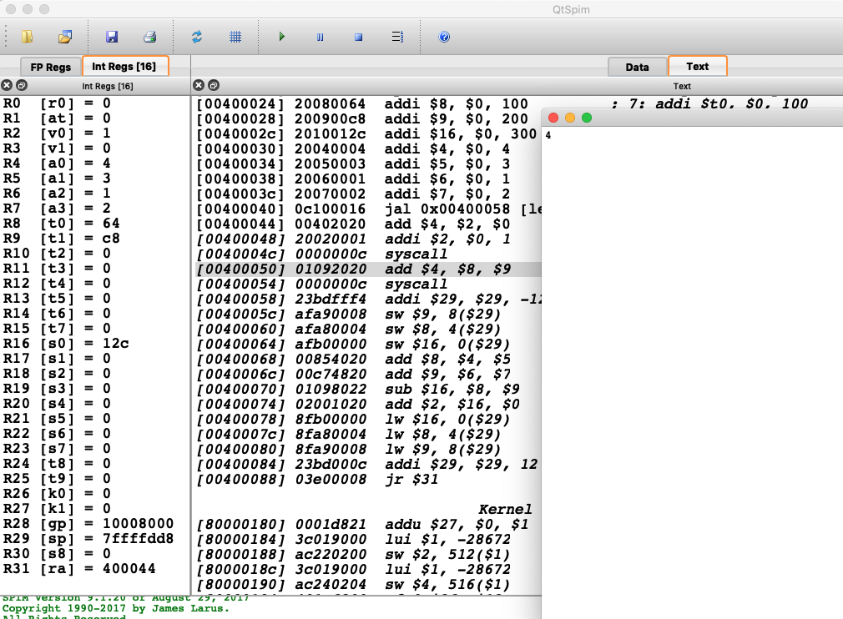

Slide 32
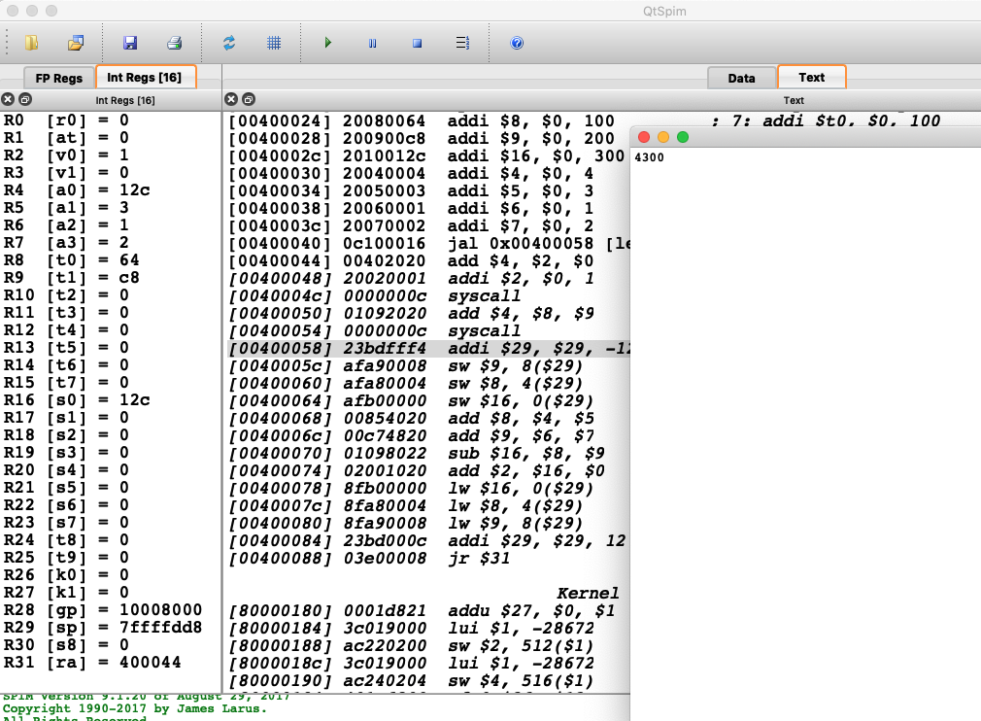

Slide 33
Why stack? 함수가 다른 함수를 호출한다면
Procedure call/returns are Last-In-First-Out
For nested call, caller needs to save on the stack:
Its return address
Any arguments and temporaries needed after the call
Restore from the stack after the call
Our Example :
SPIM startup code -> main -> leaf_example

Slide 34
Non-Leaf Example : main
main: addi $sp, $sp, -24 # main: (non_leaf example)
sw $ra, 0($sp)
sw $a0, 4($sp)
sw $a1, 8($sp)
sw $a2, 12($sp)
sw $a3, 16($sp)
sw $v0, 20($sp)
addi $a0, $0, 4 # g
addi $a1, $0, 3 # h
addi $a2, $0, 1 # i
addi $a3, $0, 2 # j
jal leaf_example # leaf_example(g,h,i,j)
add $a0, $v0, $0 # $a0 <= return value
addi $v0, $0, 1
syscall # print return value
lw $ra, 0($sp)
lw $a0, 4($sp)
lw $a1, 8($sp)
lw $a2, 12($sp)
lw $a3, 16($sp)
lw $v0, 20($sp)
addi $sp, $sp, 24
jr $ra
Save registers
including $ra on stack
set up arguments
function call
print return value
using system call
Restore registers
including $ra from stack
Return to caller

Slide 35
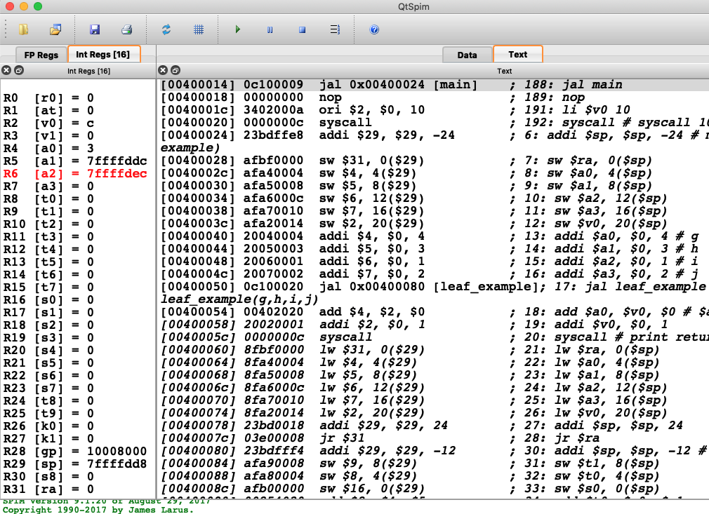
SPIM startup code calls main

Slide 36
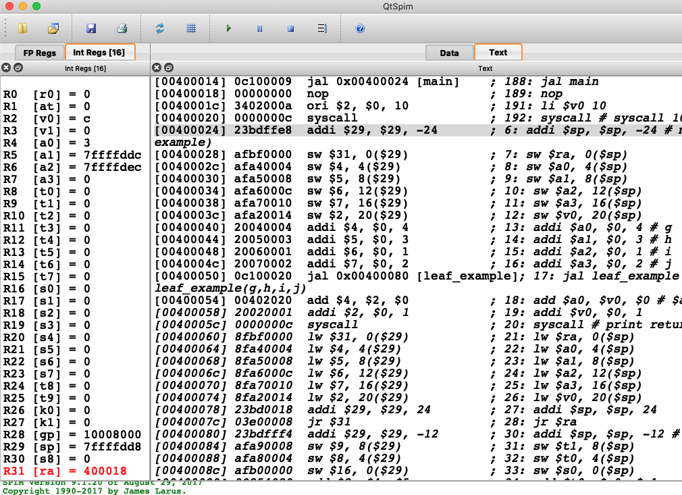

Slide 37
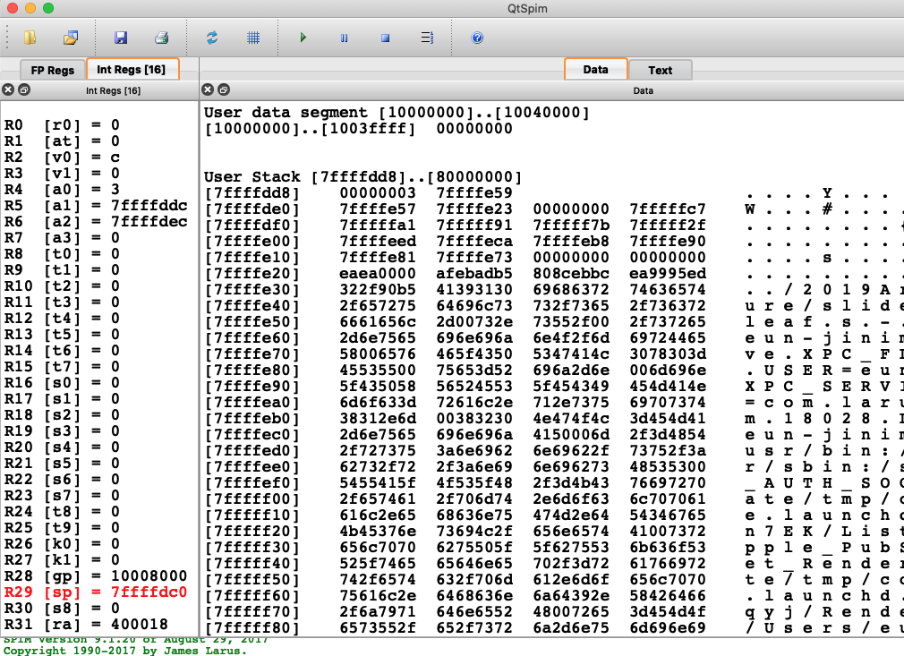
old stack top

Slide 38
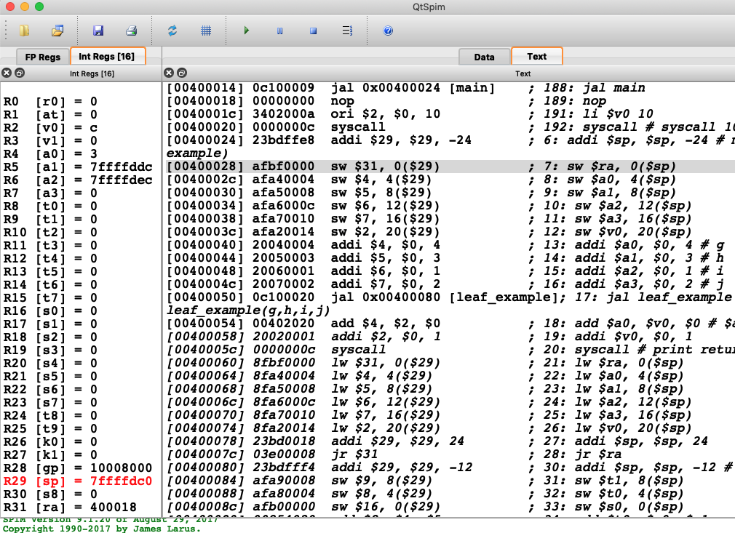

Slide 39
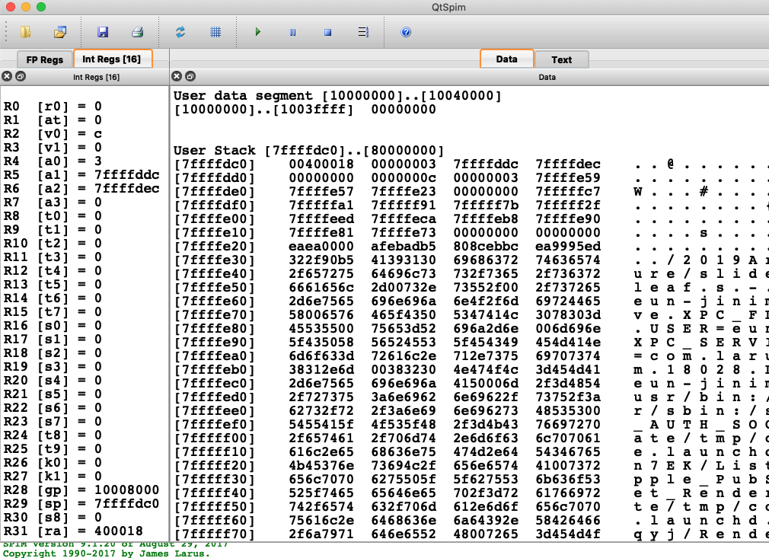

Slide 40
stack
00000003
00400018
00000003
7FFFFDDC
7FFFFDEC
00000000
0000000C
00000003
$sp = 7ffffdc0 →
$sp =7ffffdd8 →

Slide 41
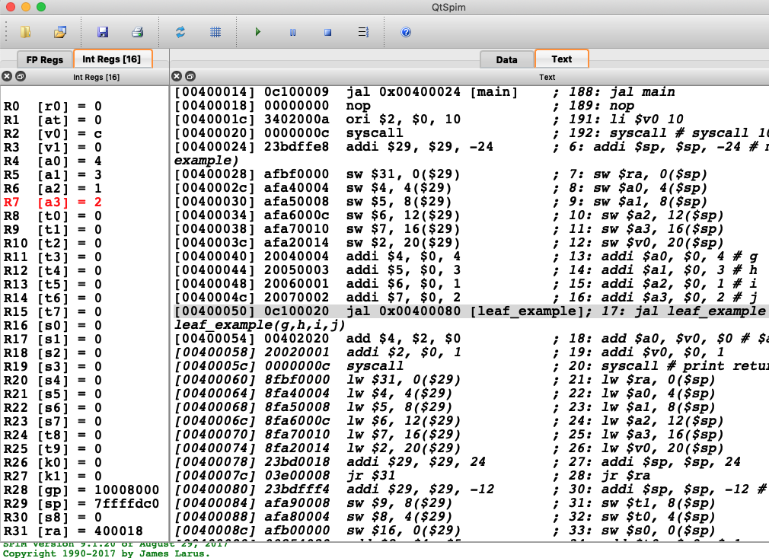

Slide 42
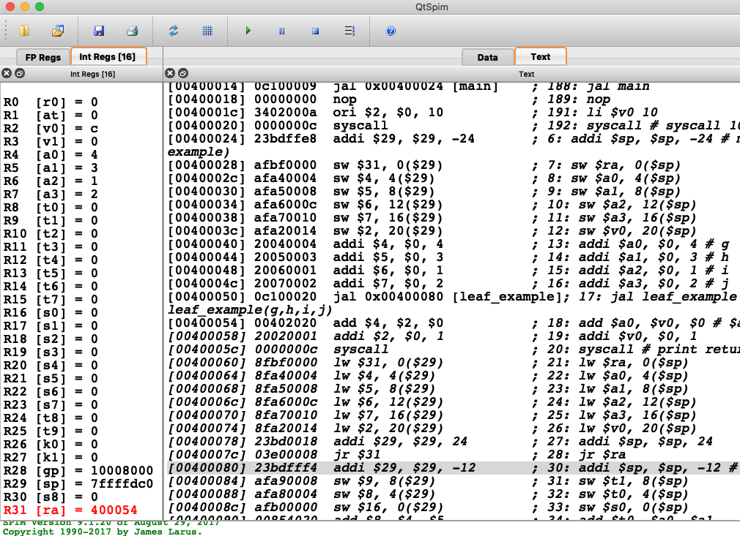

Slide 43
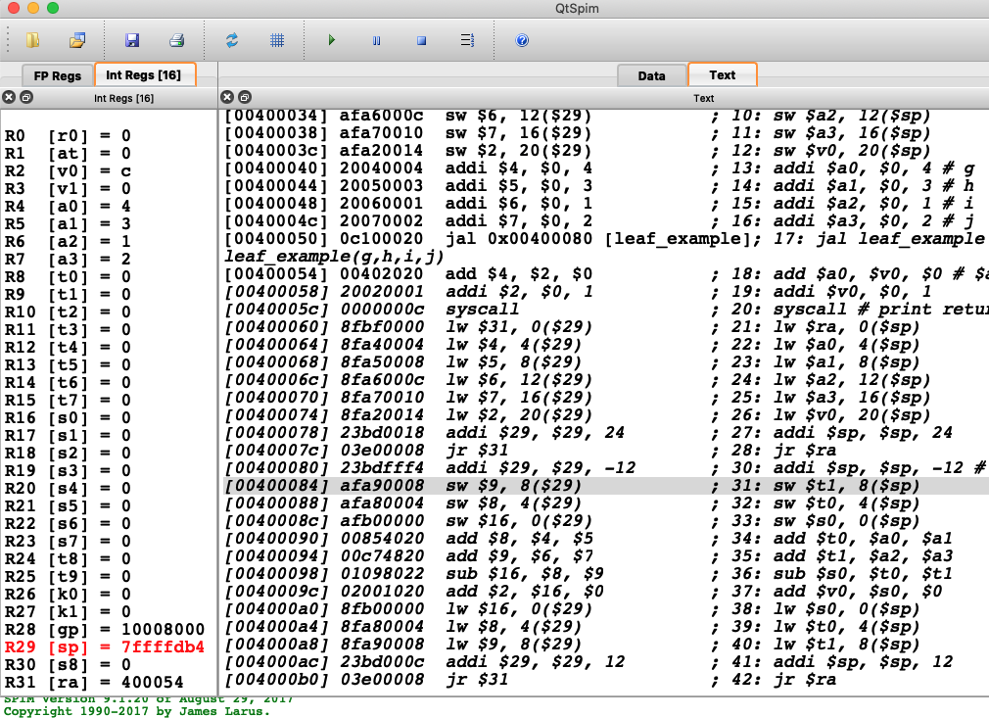

Slide 44
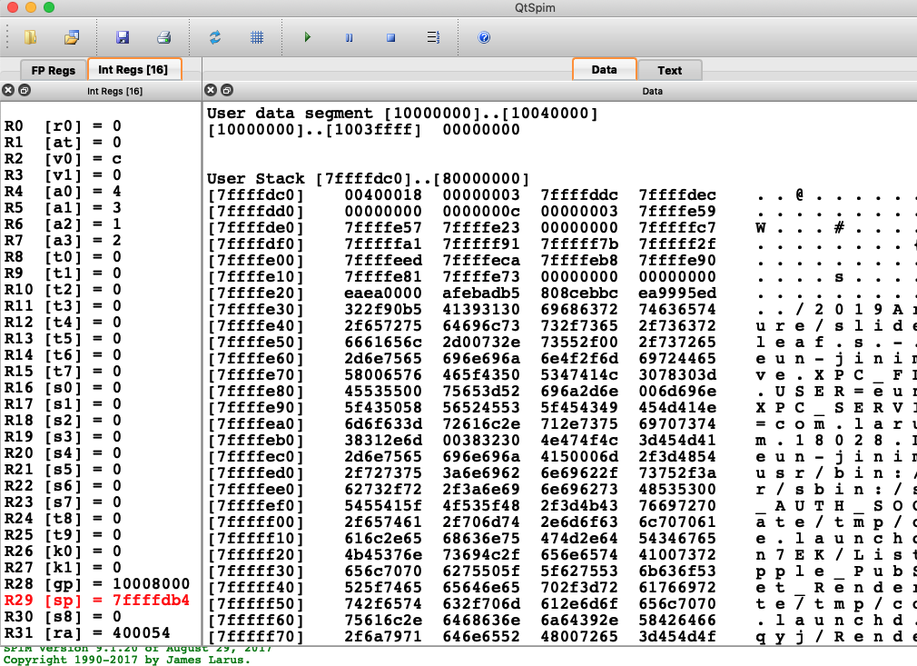
old stack top

Slide 45
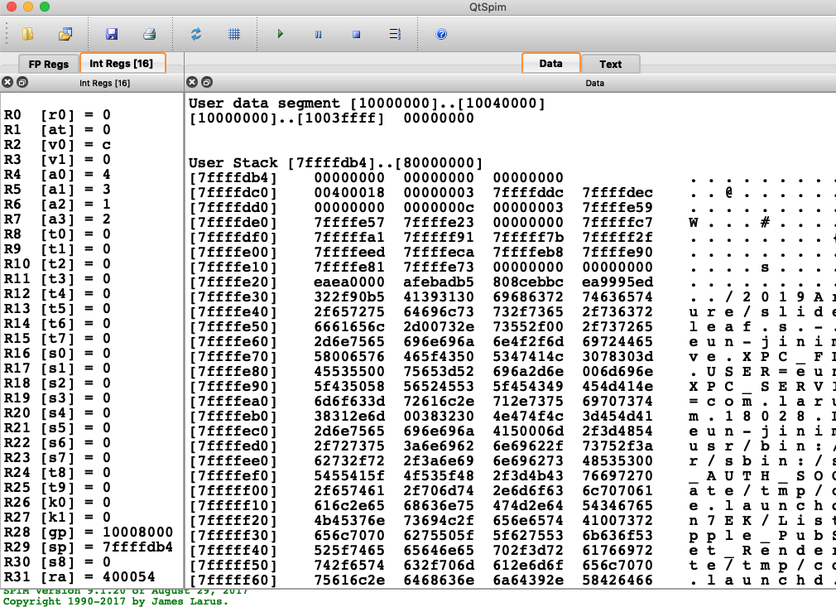

Slide 46
stack
00400018
00000003
7FFFFDDC
7FFFFDEC
00000000
0000000C
00000003
00000000
00000000
00000000
00400018
00000003
7FFFFDDC
7FFFFDEC
00000000
0000000C
00000003
$sp = 7ffffdb4 →
$sp = 7ffffdc0 →

Slide 47
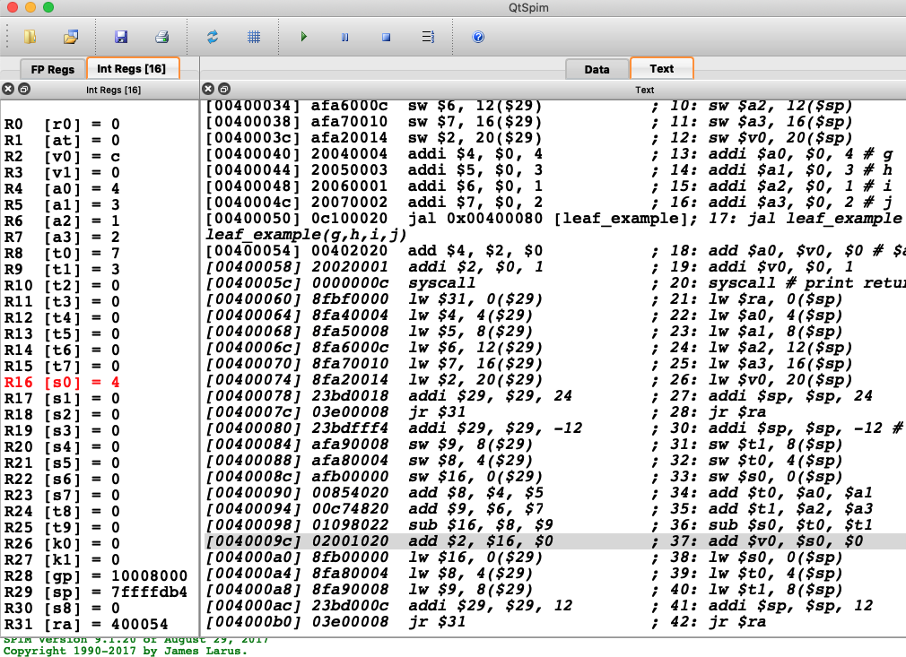

Slide 48
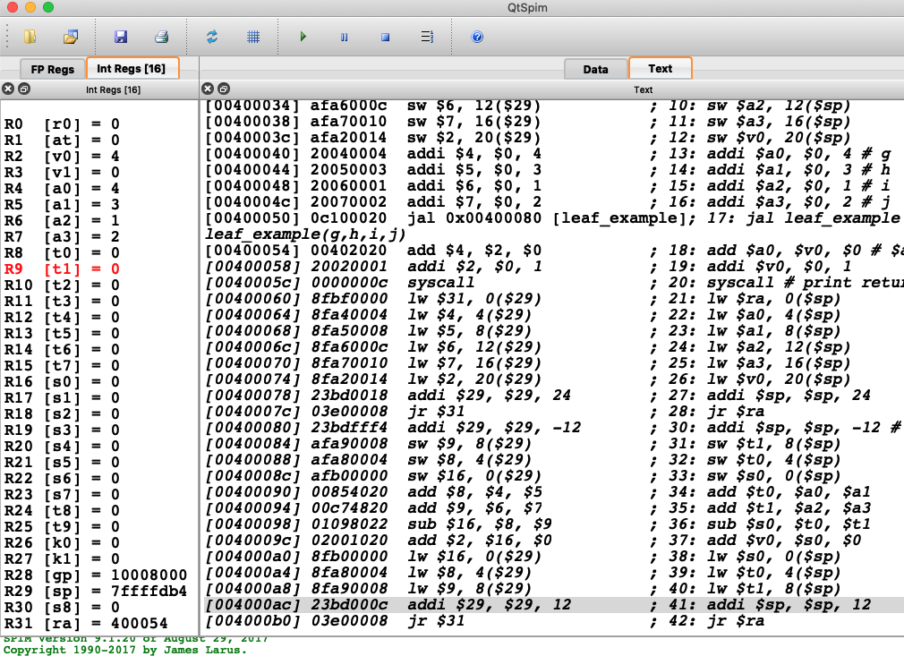

Slide 49
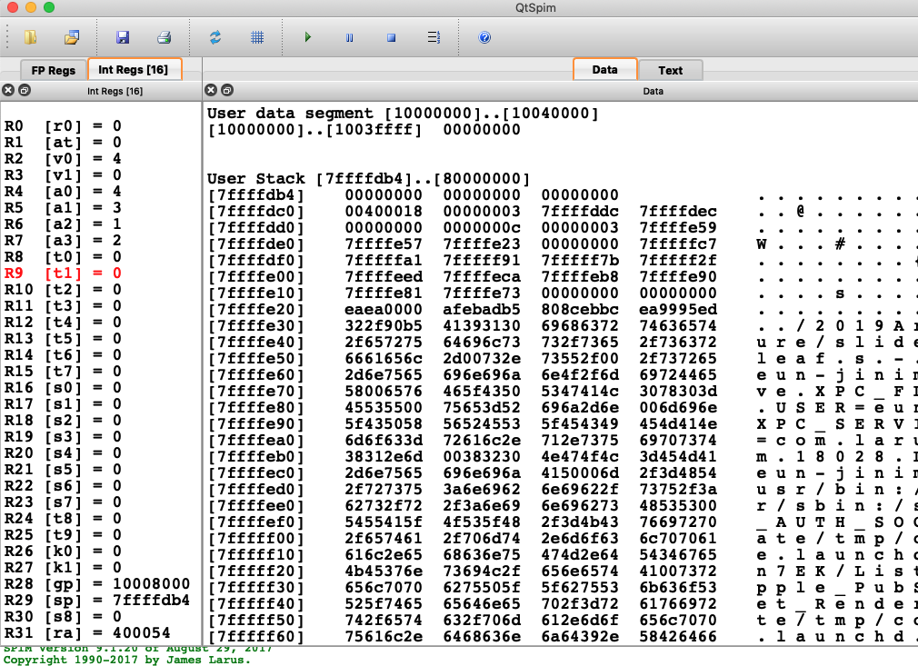

Slide 50
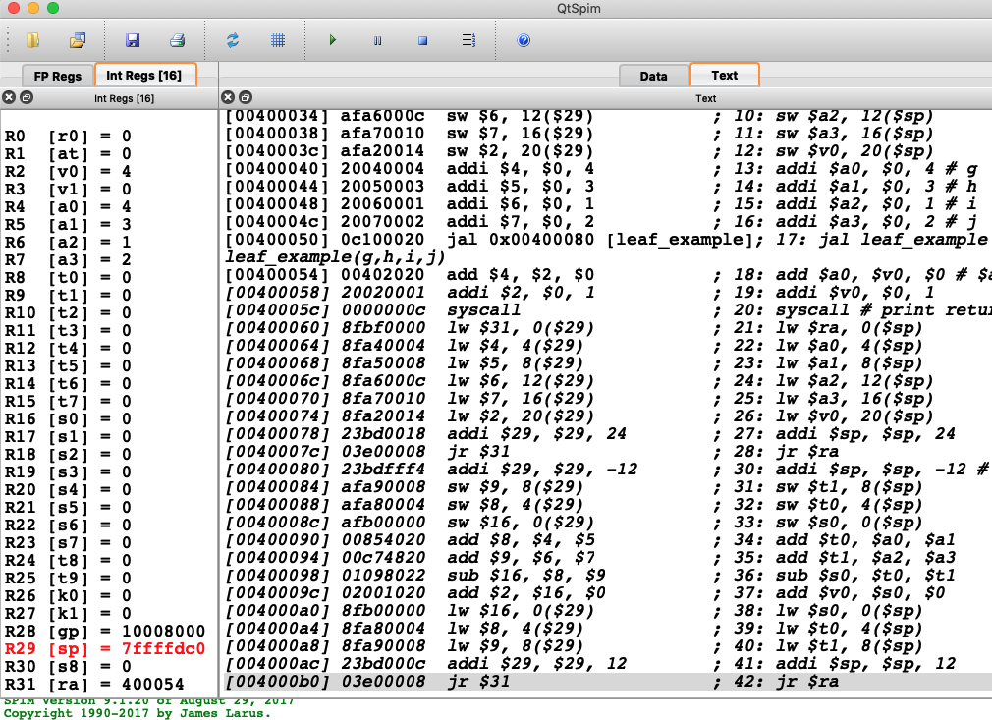

Slide 51
stack
00000000
00000000
00000000
00400018
00000003
7FFFFDDC
7FFFFDEC
00000000
0000000C
00000003
00000000
00000000
00000000
00400018
00000003
7FFFFDDC
7FFFFDEC
00000000
0000000C
00000003
$sp = 7ffffdb4 →
$sp = 7ffffdc0 →

Slide 52
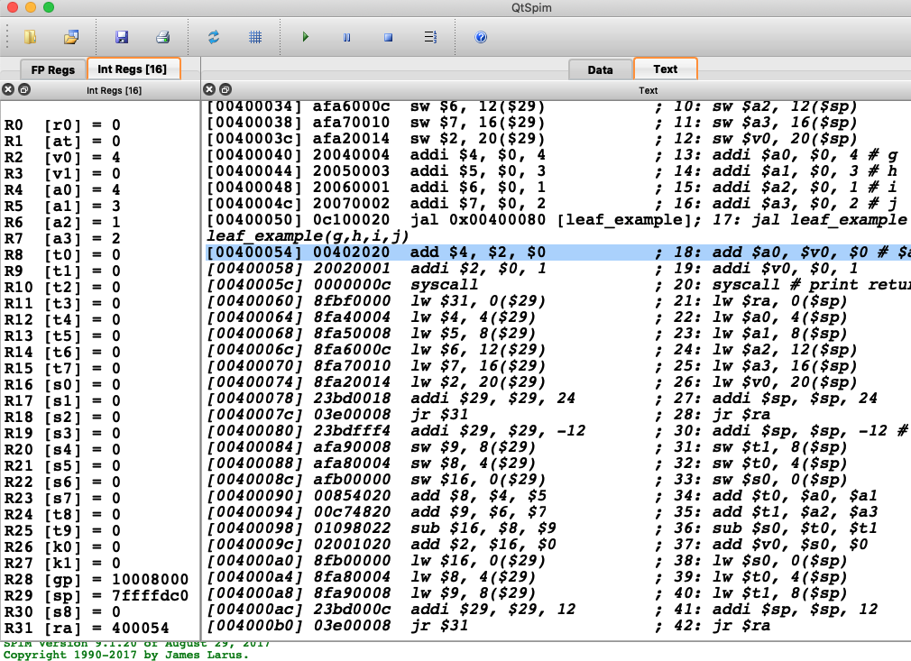

Slide 53
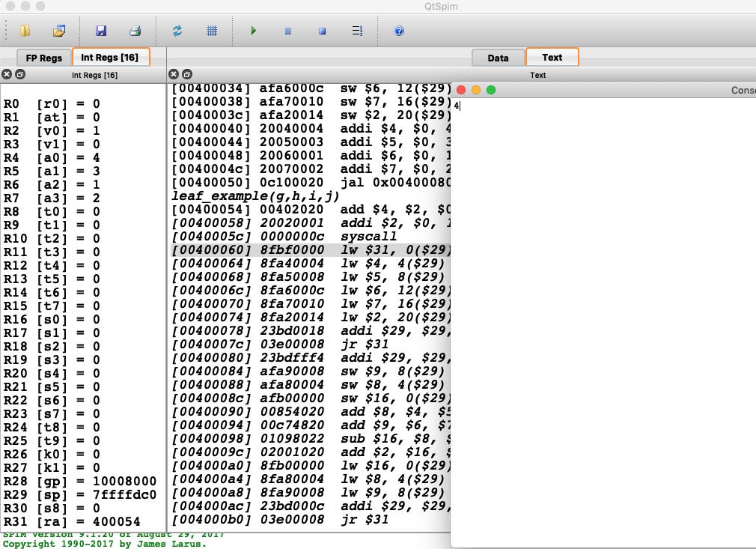

Slide 54
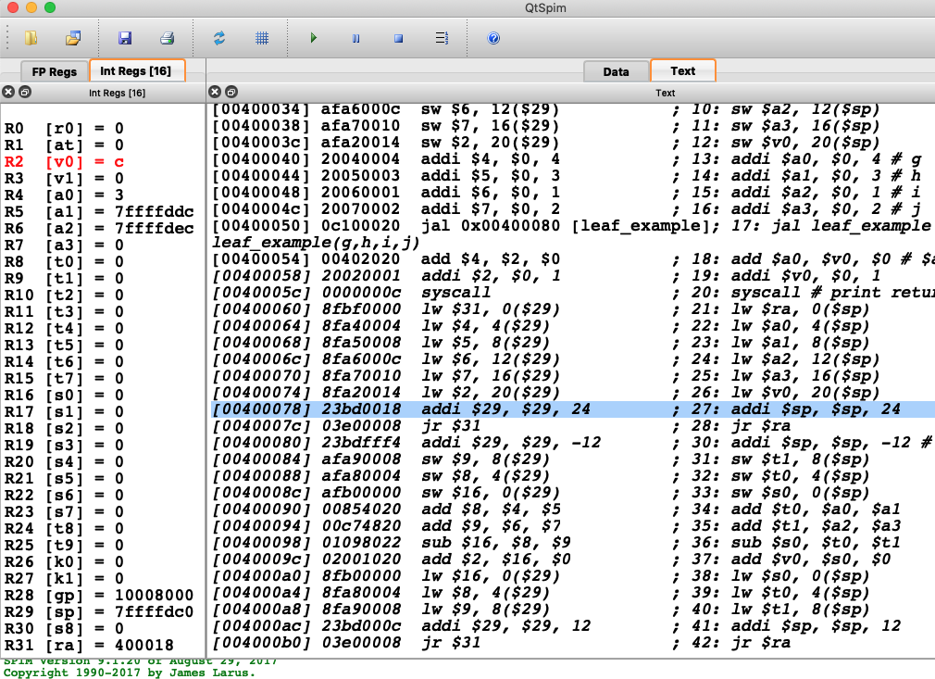

Slide 55
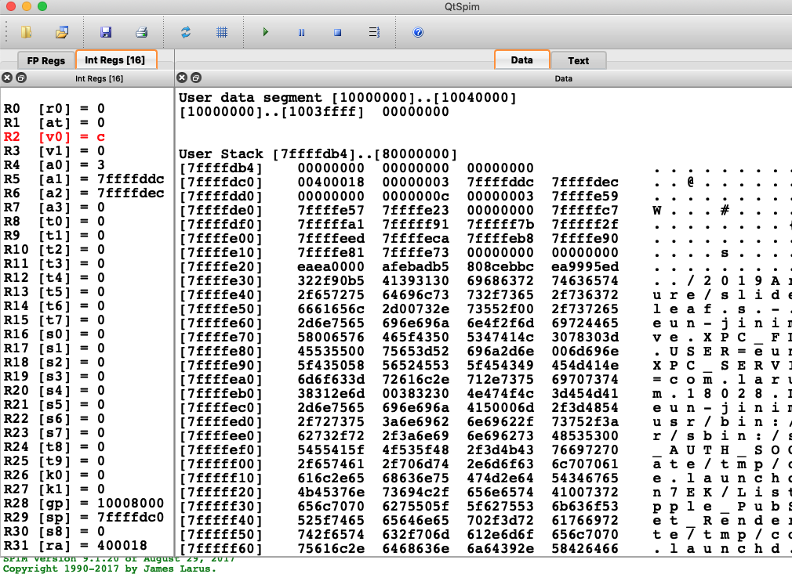

Slide 56
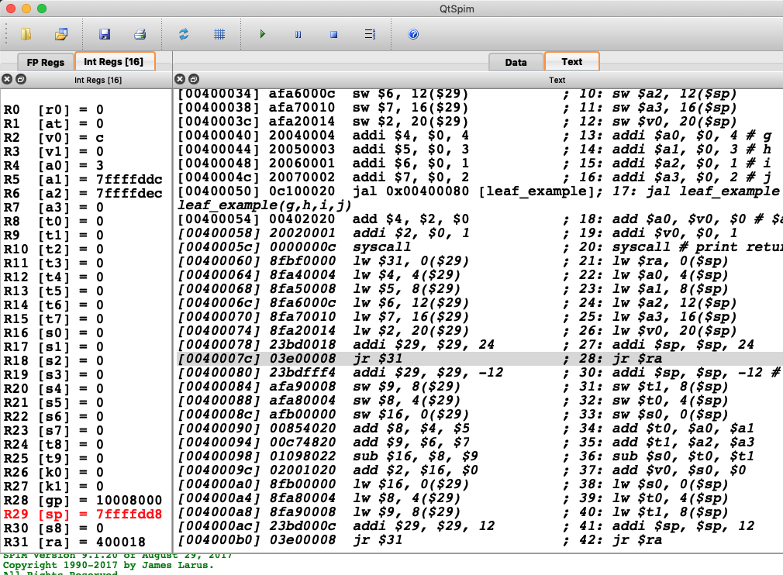

Slide 57
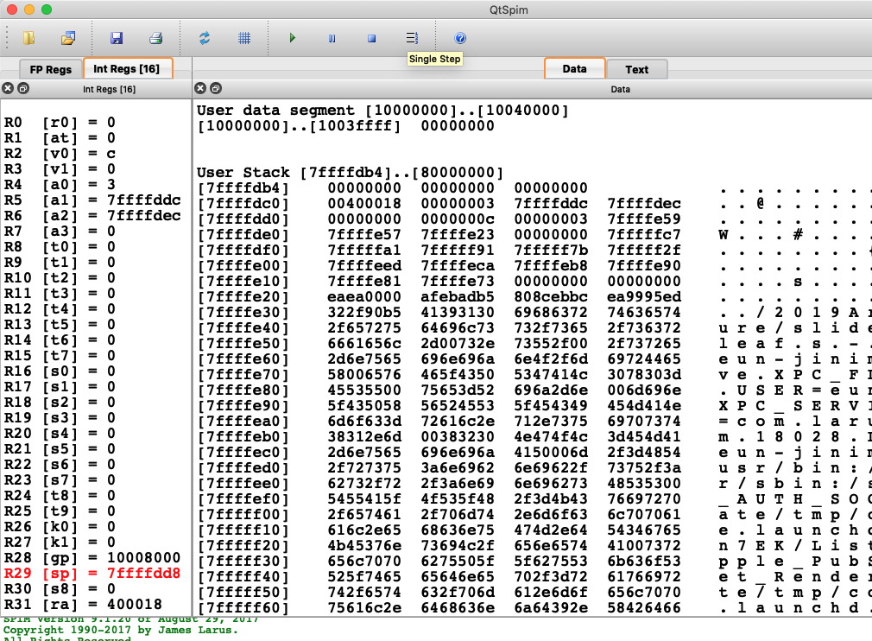

Slide 58
stack
00000000
00000000
00000000
00400018
00000003
7FFFFDDC
7FFFFDEC
00000000
0000000C
00000003
00000000
00000000
00000000
00400018
00000003
7FFFFDDC
7FFFFDEC
00000000
0000000C
00000003
$sp = 7ffffdc0 →
$sp = 7ffffdd8 →

Slide 59
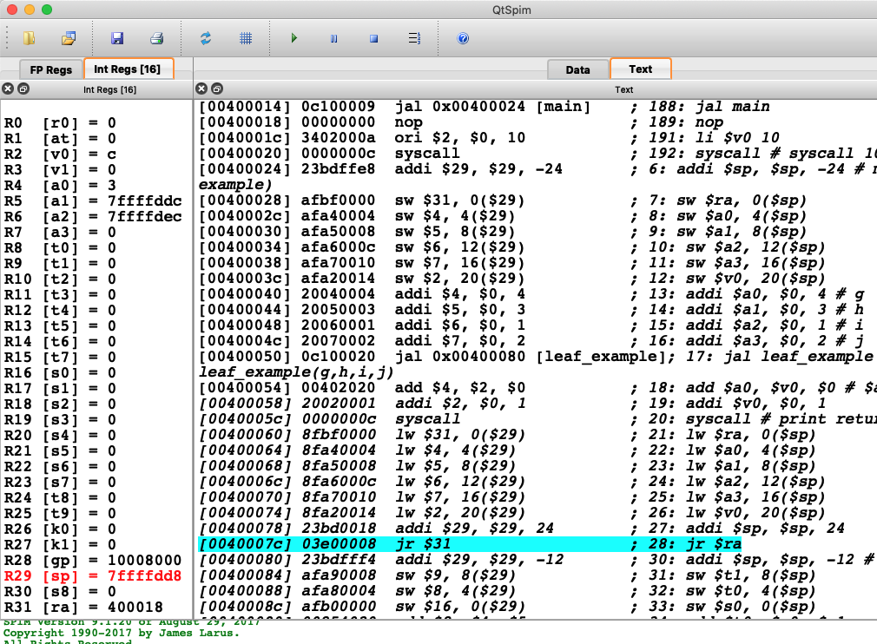

Slide 60
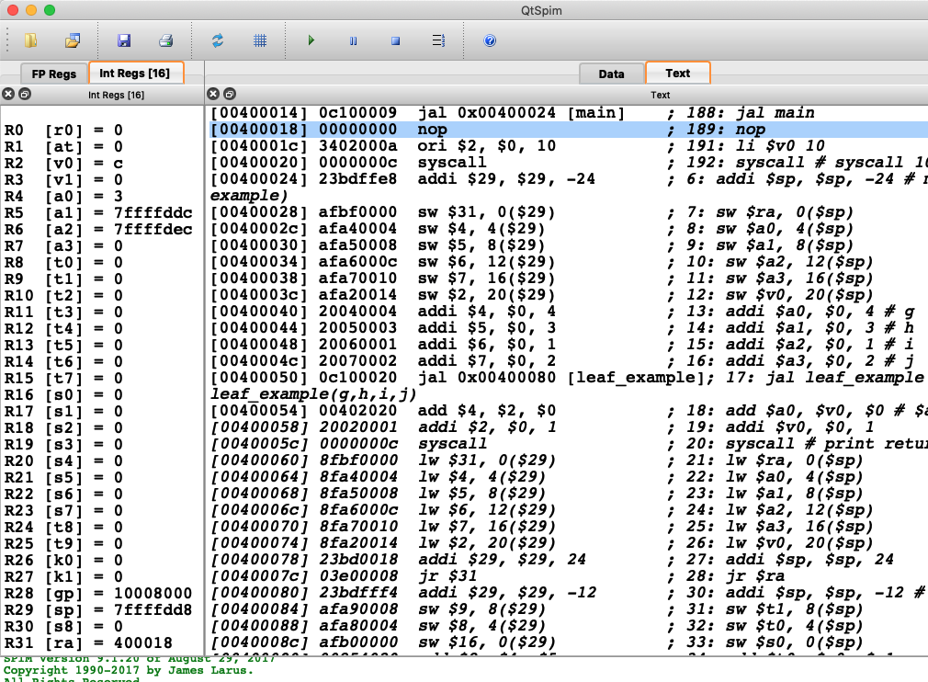

Slide 61
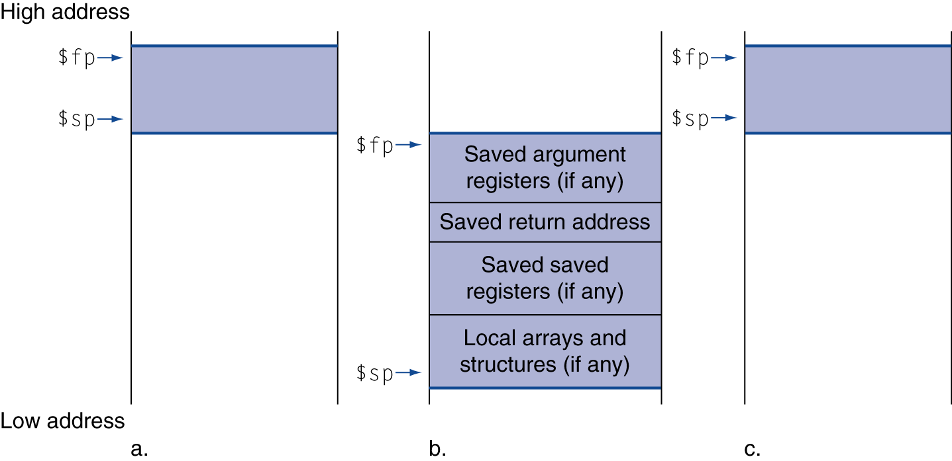
Stack 에는 함수의 지역 변수도 저장된다.
Local data allocated by callee
e.g., C automatic variables
Procedure frame (activation record)
Used by some compilers to manage stack storage

Slide 62
Recursive Procedure Example
C code:
int fact (int n) { if (n < 1) return 1; else return n * fact(n - 1); }
Argument n in $a0
Result in $v0

Slide 63
Recursive Procedure
int fact (int n) { if (n < 1) return 1; else return n * fact(n - 1); }
fact: addi $sp, $sp, -8 # adjust stack for 2 items sw $ra, 4($sp) # save return address sw $a0, 0($sp) # save argument slti $t0, $a0, 1 # test for n < 1 beq $t0, $zero, L1 addi $v0, $zero, 1 # if so, result is 1 addi $sp, $sp, 8 # pop 2 items from stack jr $ra # and return L1: addi $a0, $a0, -1 # else decrement n jal fact # recursive call lw $a0, 0($sp) # restore original n lw $ra, 4($sp) # and return address addi $sp, $sp, 8 # pop 2 items from stack mul $v0, $a0, $v0 # multiply to get result jr $ra # and return

Slide 64
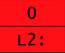
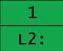
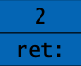
recursive call to fact with $a0=2
main : addi $a0, $0, 2
jal fact
ret: nop
fact: addi $sp, $sp, -8 # adjust stack for 2 items sw $ra, 4($sp) # save return address sw $a0, 0($sp) # save argument slti $t0, $a0, 1 # test for n < 1 beq $t0, $zero, L1 addi $v0, $zero, 1 # if so, result is 1 addi $sp, $sp, 8 # pop 2 items from stack jr $ra # and return L1: addi $a0, $a0, -1 # else decrement n jal fact # recursive call L2: lw $a0, 0($sp) # restore original n lw $ra, 4($sp) # and return address addi $sp, $sp, 8 # pop 2 items from stack mul $v0, $a0, $v0 # multiply to get result jr $ra # and return
$a0=
2 1 0
stack
$sp→
$sp→
$sp→
$sp→

Slide 65
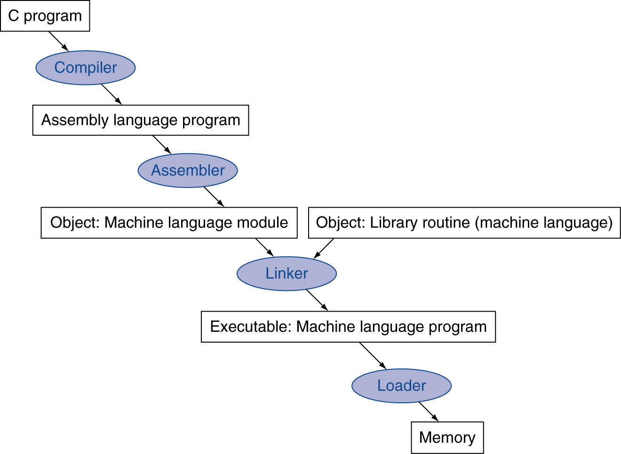
Translation and Startup
Many compilers produce object modules directly
§2.12 Translating and Starting a Program
Static linking

Slide 66
Producing an Object Module
Assembler (or compiler) translates program into machine instructions
Provides information for building a complete program from the pieces
Header: describes contents of object module
Text segment: translated instructions
Static data segment: data allocated for the life of the program
Relocation info: for contents that depend on absolute location of loaded program
Symbol table: global definitions and external refs
Debug info: for associating with source code

Slide 67
Linking Object Modules (Static)
Produces an executable image
1. Merges segments
2. Resolve labels (determine their addresses)
3. Patch location-dependent and external refs
Could leave location dependencies for fixing by a relocating loader
But with virtual memory, no need to do this
Program can be loaded into absolute location in virtual memory space

Slide 68
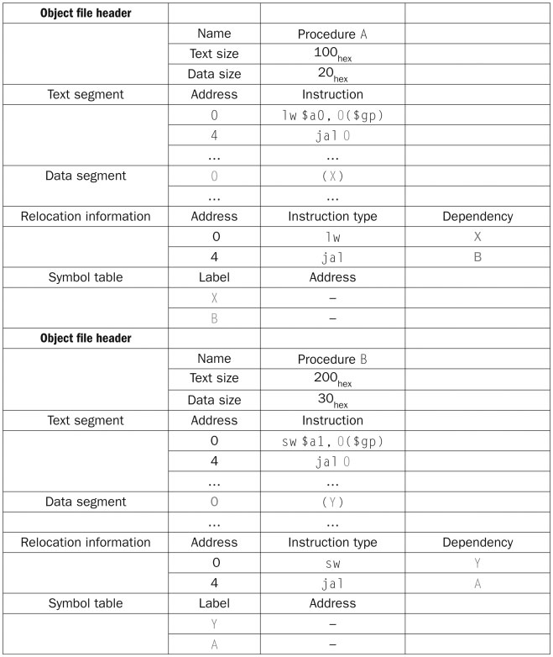
Copyright © 2014 Elsevier Inc. All rights reserved.

Slide 69

A:
B:
R[$gp] 0x10008000
+ 0x????8000 (? = 0xF, due to sign extention)
= 0x10000000
extern in C, .globl in MIPS assembly 가 symbol 의 외부 참조를 가능하게 함
Copyright © 2014 Elsevier Inc. All rights reserved.

Slide 70
Loading a Program
Load from image file on disk into memory
1. Read header to determine segment sizes
2. Create virtual address space
3. Copy text and initialized data into memory
Or set page table entries so they can be faulted in
4. Set up arguments on stack
5. Initialize registers (including $sp, $fp, $gp)
6. Jump to startup routine
Copies arguments to $a0, … and calls main
When main returns, do exit syscall

Slide 71
Dynamic Linking
Only link/load library procedure when it is called
Requires procedure code to be relocatable
Avoids image bloat caused by static linking of all (transitively) referenced libraries
Automatically picks up new library versions

Slide 72

Lazy Linkage
Indirection table
Stub: Loads routine ID, Jump to linker/loader
Linker/loader code
Dynamically mapped code

